Slide 1

APOLLO TYRES

Slide 2
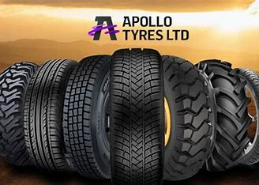
PROJECT NAME: APOLLOTYRES
TEAM LEADER:
NAKKA SWATHI
TEAM MEMBERS:
MUKALLA ROJA
MANEM BHARGAVI
MYLAPILLI LIKITHA
LUTTA ROHINI

Slide 3
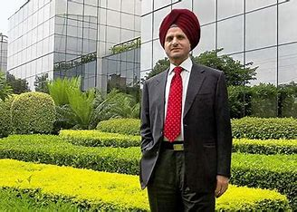
INTRODUCTION
Apollo Tyres was founded by Raunaq Singh in 1972. Raunaq Singh is an Indian entrepreneur who played a pivotal role in establishing the company as a prominent player in the tire manufacturing industry. Under his leadership, Apollo Tyres has grown to become a global tire manufacturer with a strong presence in various markets around the world

Slide 4
Research Brand:APOLLO TYRES
Mission/Values:Our core values –apollo tyres, best reflect what we do and believe in: Be passionate with client’s success. Treat each person with respect. Be global and responsible. Unyielding integrity in everything we do.

Slide 5

Unique Selling Proposition (USP):
Apollo Tyres stands out with its unique selling proposition by offering high-quality, durable tires that combine cutting-edge technology with a commitment to sustainability. With a global presence and a focus on innovation, Apollo Tyres provides customers with reliable, eco-friendly, and performance-driven tire solutions, making them a top choice for discerning consumers.

Slide 6
Analyse Brand tone and Identity:
Apollo Tyres' brand identity is a blend of reliability, innovation, sustainability, responsibility, and global awareness, making them a reputable and forward-thinking tire brand.
Apollo Tyres has a strong global presence, and their brand tone reflects a sense of inclusivity and adaptability
They cater to diverse markets and audiences, positioning themselves as a tire manufacturer that understands the varying needs of customers worldwide.
Their brand identity also emphasizes sustainability and corporate responsibility.

Slide 7
Smart Goals of APOLLO TYRES :
To increase their market presence by entering three new international markets within the next two years, targeting a specific sales growth percentage.
Reduce their carbon footprint by implementing energy-efficient processes and achieving a specific reduction in greenhouse gas emissions over the next five years.
Achieve a customer satisfaction rating of 95% or higher within the next year by improving product quality, service delivery, and response times.

Slide 8
Key Performance Indicators:
Tracking year-over-year revenue growth to measure the company's financial performance and market expansion.
Monitoring metrics related to product quality, such as defect rates and warranty claims, to ensure the production of high-quality tires.
Measuring environmental KPIs, including carbon emissions, waste reduction, and energy efficiency improvements, to assess their commitment to sustainability and responsible manufacturing.

Slide 9
Key Performance Indicators (KPIs):
Measuring sales and net profit to gauge financial health.
Assessing the company's position in the tire industry.
Monitoring manufacturing output and cost-effectiveness.
Evaluating product quality and safety standards.
Using customer feedback and surveys to Managing inventory, distribution, and supplier relationships.
Tracking eco-friendly practices and reducing the
Measuring the success and impact of research and development efforts, including new tire technologies and designs.

Slide 10
Buyer’s Audience Persona:
Many of Apollo Tyres' buyers are professional fleet managers who are concerned with the safety, durability, and cost-efficiency of tires for their commercial vehicles. They are looking for reliable, long-lasting tires that can withstand heavy usage.
Some buyers are individuals who are environmentally conscious and seek eco-friendly tire options. They prioritize sustainability and reduced carbon footprint in their tire choices.
Apollo Tyres also caters to global distributors and dealers who are interested in forming partnerships with the company

Slide 11
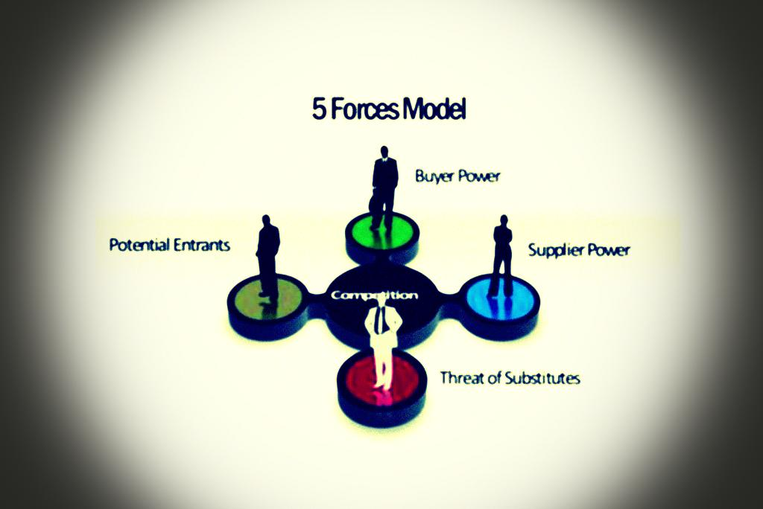
Forces models:

Slide 12
Competitor Analysis:
Apollo tyres faces competition from several major players in the IT industry, including MRF and CART.
These competitors offer similar services and solutions, and each has its own strengths and weaknesses.
APOLLO TYRES key strengths lie in its global presence, diverse portfolio of services, and strong customer relationships.

Slide 13
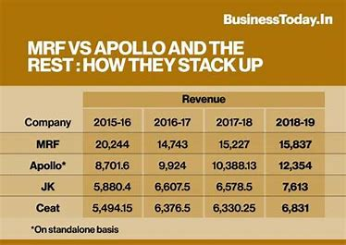

Slide 14
SearCh Engine Optimization Audit(SEO):
Apollo Tyres, a global leader in tire manufacturing, employs a robust SEO strategy to enhance online visibility and connect with its target audience. This approach includes optimizing their website for relevant keywords like "tire manufacturer" and "quality tires." They create high-quality, informative content about tire-related topics, improving search engine rankings. Local SEO efforts ensure their presence in various markets. Apollo Tyres actively monitors and manages online reviews and engages with customers on social media platforms. Their commitment to SEO enables them to stay competitive in the digital landscape, attracting more potential customers and fostering brand recognition

Slide 15
Keyword Research:
Tire Types: Keywords related to various tire types they offer, such as "summer tires," "winter tires," "all-season tires," and "commercial truck tires."
Geographic Locations: Location-specific keywords, including "Apollo Tyres USA," "Apollo Tyres India," and other regional variations, to target customers in specific areas.
Brands and Models: Keywords related to specific tire brands or models, like "Apollo Alnac," "Apollo Aspire," or "Apollo Apterra," to cater to customers searching for specific products.

Slide 16
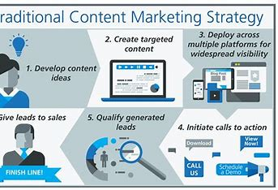
Content Ideas And Marketing Strategies:

Slide 17
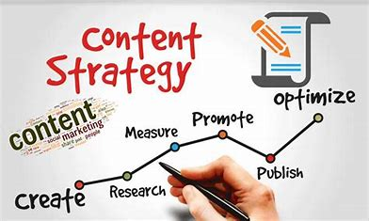
Content Idea Generation And Strategy:
Develop a series of informative articles and videos on proper tire maintenance, tire safety, and the importance of choosing the right tires for different seasons and vehicles. This content can be published on their website and social media platforms to educate and engage their audience.

Slide 18
Marketing Strategies:
The market analysis of Apollo Tyres encompasses a comprehensive review of the tire industry, including market size, trends, and consumer preferences. It investigates key competitors, pricing strategies, and distribution channels. Apollo Tyres' competitive strategies may involve product innovation, branding, and market expansion. This analysis explores market dynamics, potential growth areas, and potential challenges. It helps Apollo Tyres make informed decisions to enhance market share, strengthen brand presence, and remain competitive in a dynamic industry, fostering long-term success.

Slide 19
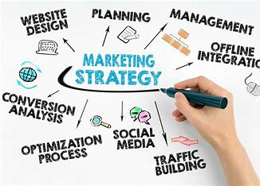

Slide 20
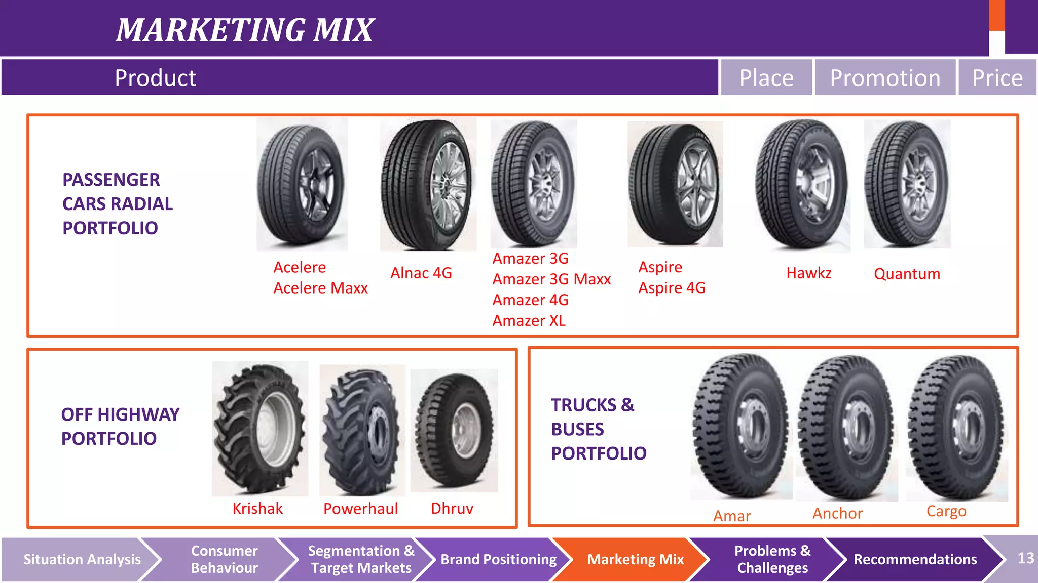

Slide 21
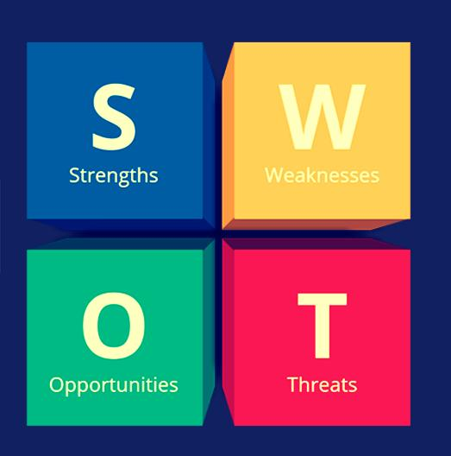

Slide 22
Strengths:
Global Presence
Innovation in Tire Technology
Reputation for Quality
Commitment to Sustainability
Weaknesses:
Intense Competition
Sensitivity to Economic Trends
Regional Risks
Opportunities:
Growth in Automotive Market
Sustainability Trends
Technological Advancements
Threats:
Economic Downturns
Commodity Price Fluctuations
Regulatory Changes

Slide 23
Analysis of APOLLO TYRES
Global Footprint: Apollo Tyres has established a strong global presence, with manufacturing and distribution networks across multiple countries, giving them access to diverse markets and customers.
Innovation and Quality: The company's core strengths lie in their commitment to innovation in tire technology, consistently producing high-quality and durable tires that have earned them a reputation for reliability.
Sustainability Focus: Apollo Tyres' dedication to sustainability and eco-friendly practices aligns well with the growing demand for responsible and environmentally conscious products, enhancing their brand image and market positioning.

Slide 24
SOCIAL MEDIA LINKS
Please check my Instagram profile👇
https://instagram.com/apllo4849?igshid=OGQ5ZDc2ODk2ZA==
Please follow my Facebook page👇
https://www.facebook.com/profile.php?id=61551864841990&mibextid=ZbWKwL
Please check my stories/highlights in Instagram 👇
https://instagram.com/stories/apllo4849/3211827419063734084?igshid=NjZiM2M3MzIxNA==
https://instagram.com/stories/apllo4849/3211829106272638017?igshid=NjZiM2M3MzIxNA==
https://instagram.com/stories/apllo4849/3211829606141579881?igshid=NjZiM2M3MzIxNA==
https://instagram.com/stories/apllo4849/3211830316816129960?igshid=NjZiM2M3MzIxNA==

Slide 25
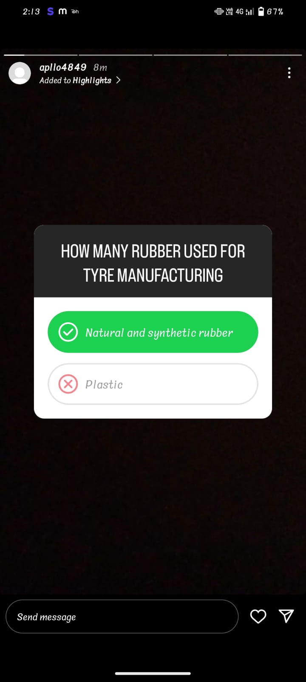
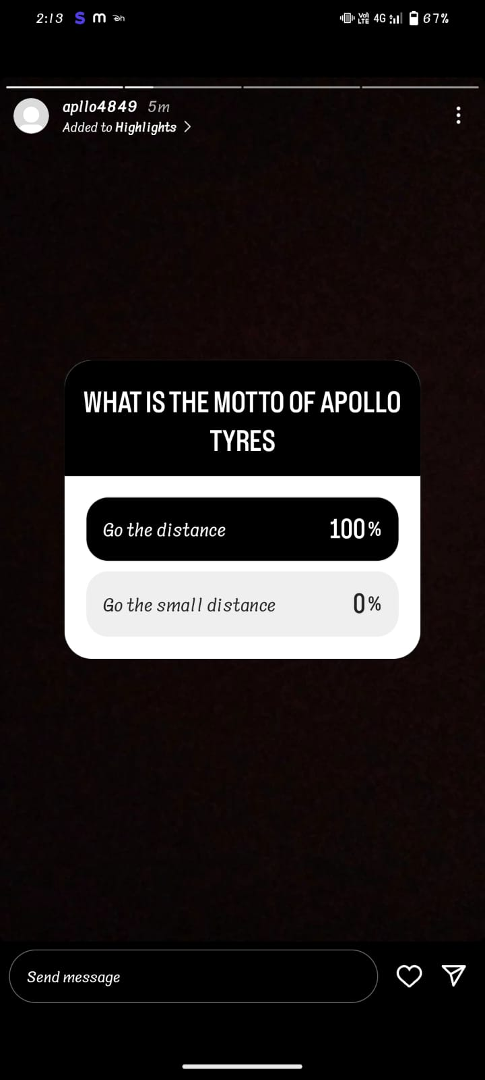
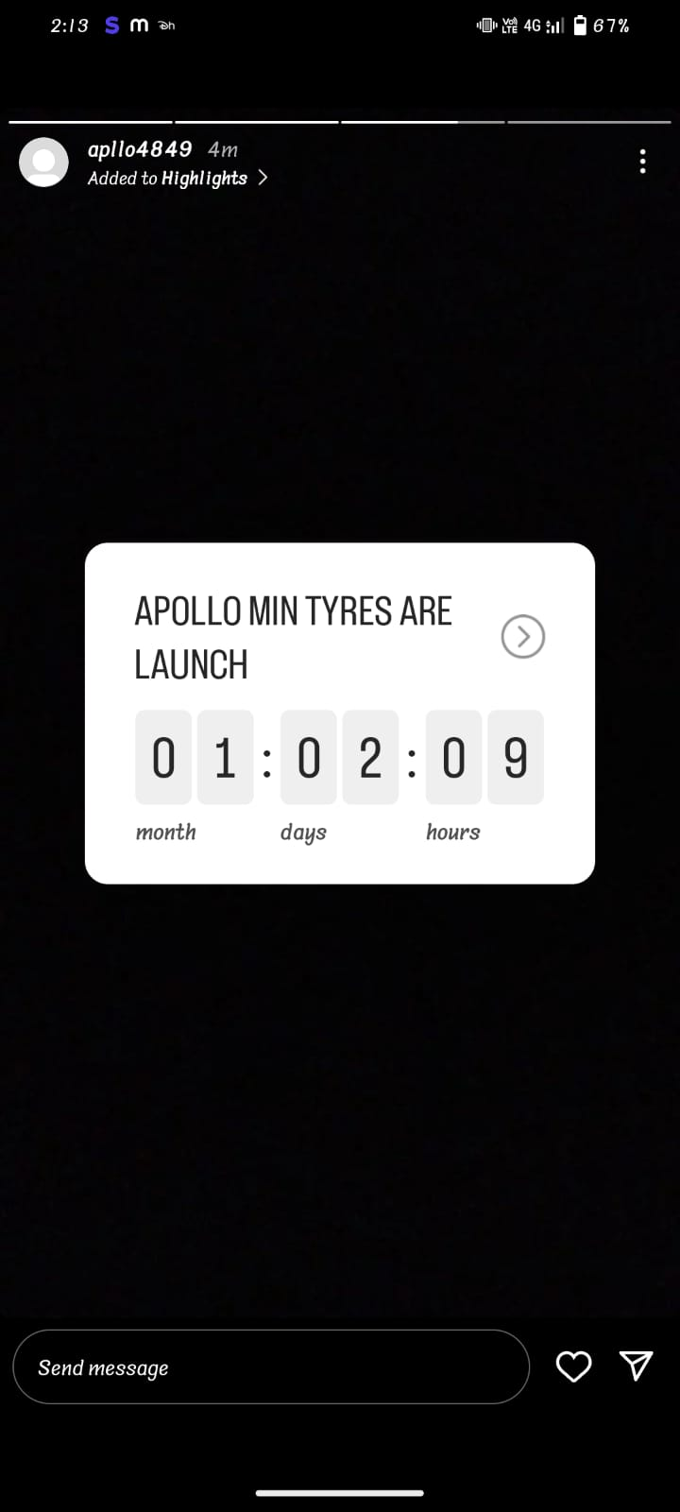

Slide 26
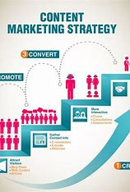

Slide 27
THANK YOU

